Slide 1
Backpropagation algorithm

Slide 2
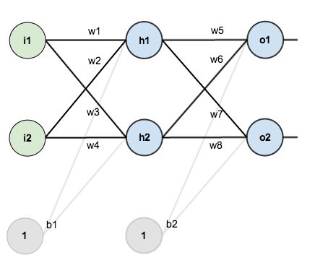
Overview

Slide 3
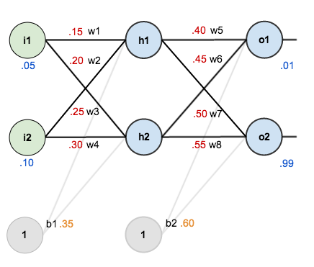
Overview

Slide 4
The Forward Pass

Slide 5

${net}_{h1}=w_{1}⋅i_{1}+w_{2}⋅i_{2}+b_{1}⋅1$
${net}_{h2}=$ $w_{3}⋅i_{1}+w_{4}⋅i_{2}+b_{1}⋅1$
${out}_{h1}=\frac{1}{1+e^{−{net}_{h1}}}$
${out}_{h2}=\frac{1}{1+e^{−{net}_{h2}}}$

Slide 6

${net}_{o1}=w_{5}⋅{out}_{h1}+w_{6}⋅{out}_{h2}+b_{2}⋅1$
${net}_{o2}=w_{7}⋅{out}_{h1}+w_{8}⋅{out}_{h2}+b_{2}⋅1$
${out}_{o1}=\frac{1}{1+e^{−{net}_{o1}}}$
${out}_{o2}=\frac{1}{1+e^{−{net}_{o2}}}$

Slide 7
Calculating the Total Error

Slide 8

$$E_{total}=\sum{\frac{1}{2}{\left(target−output\right)}^{2}}$$
$E_{o1}=\frac{1}{2}{\left({target}_{o1}−out_{o1}\right)}^{2}$
$E_{o2}=\frac{1}{2}{\left({target}_{o2}−out_{o2}\right)}^{2}$
$E_{total}=$ $E_{o1}$+ $E_{o2}$

Slide 12
Источники

